Slide 1
EDA Project – fundraising insights for donorschoose
By KB The Analyst

Slide 2
Agenda
Business Context & Problem
Takeaways
A Glance at the Numbers
Donation Summary
Donor Summary
Project Insights
Conclusion

Slide 3
Business context

Slide 4
Business context
Founded in 2010 in New York City, DonorsChoose is a non-profit organization with a website platform for public school teachers in the United States to post requests (projects) for classroom resources

Slide 5
Business context (Continued)
DonorsChoose is committed to combating racial and socioeconomic inequity in school funding by empowering teachers with projects in underrepresented, low-income communities.

Slide 6
Business problem
Explore data that was collected between 2012 and 2018 to provide an overview of the impact of donor projects posted online

Slide 7
takeaways

Slide 8
TAKEAWAYS
Months with greatest activity in terms of donations received & projects created are August and September
The top 10 donor states are in the most populated states in the US
Top 10 cities that requested donors are in areas that experienced rapid growth in ethnic diversity amongst youth
Research suggests that participating urban schools are in low-income areas

Slide 9
A glance at the numbers

Slide 10
A glance at the numbers
Total dollar amount of donations: $284,408,243.28
Total number of donations: 4,687,884
Total number of donors: 2,122,640
Total number of projects created: 1,110,017

Slide 11
Donation summary

Slide 12
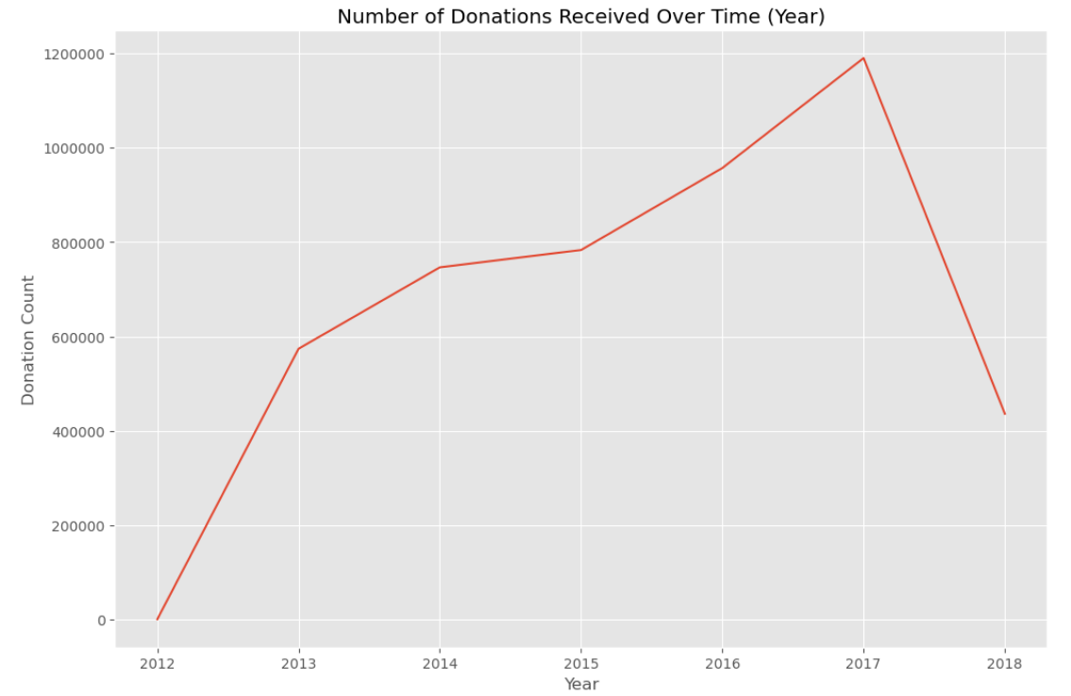
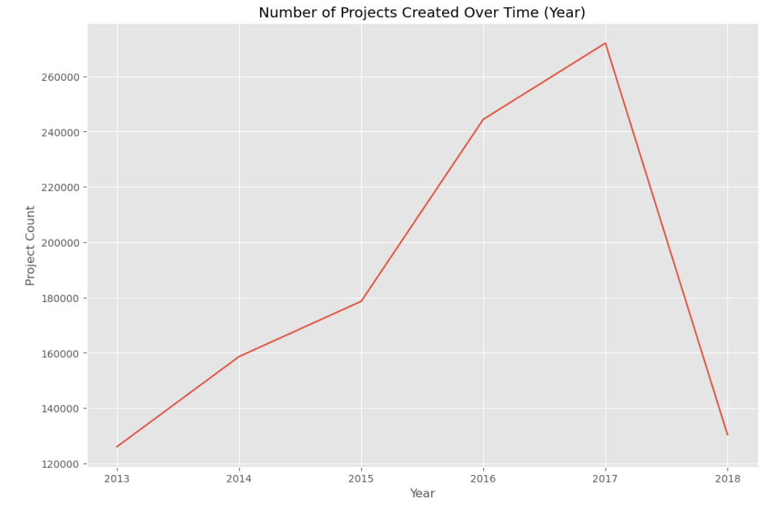
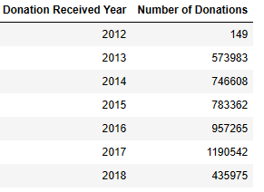
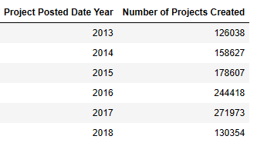
donation activity over time

Slide 13
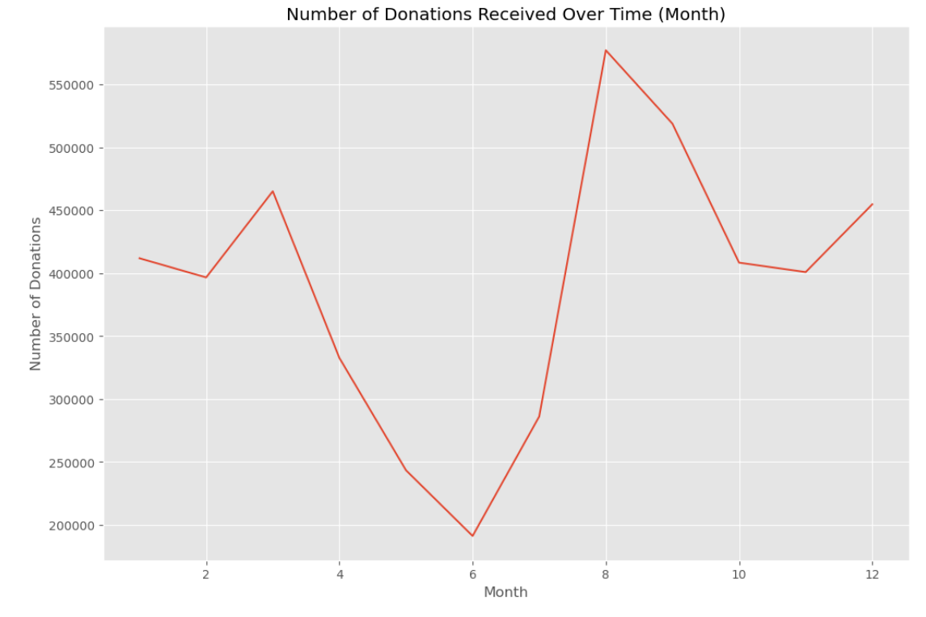
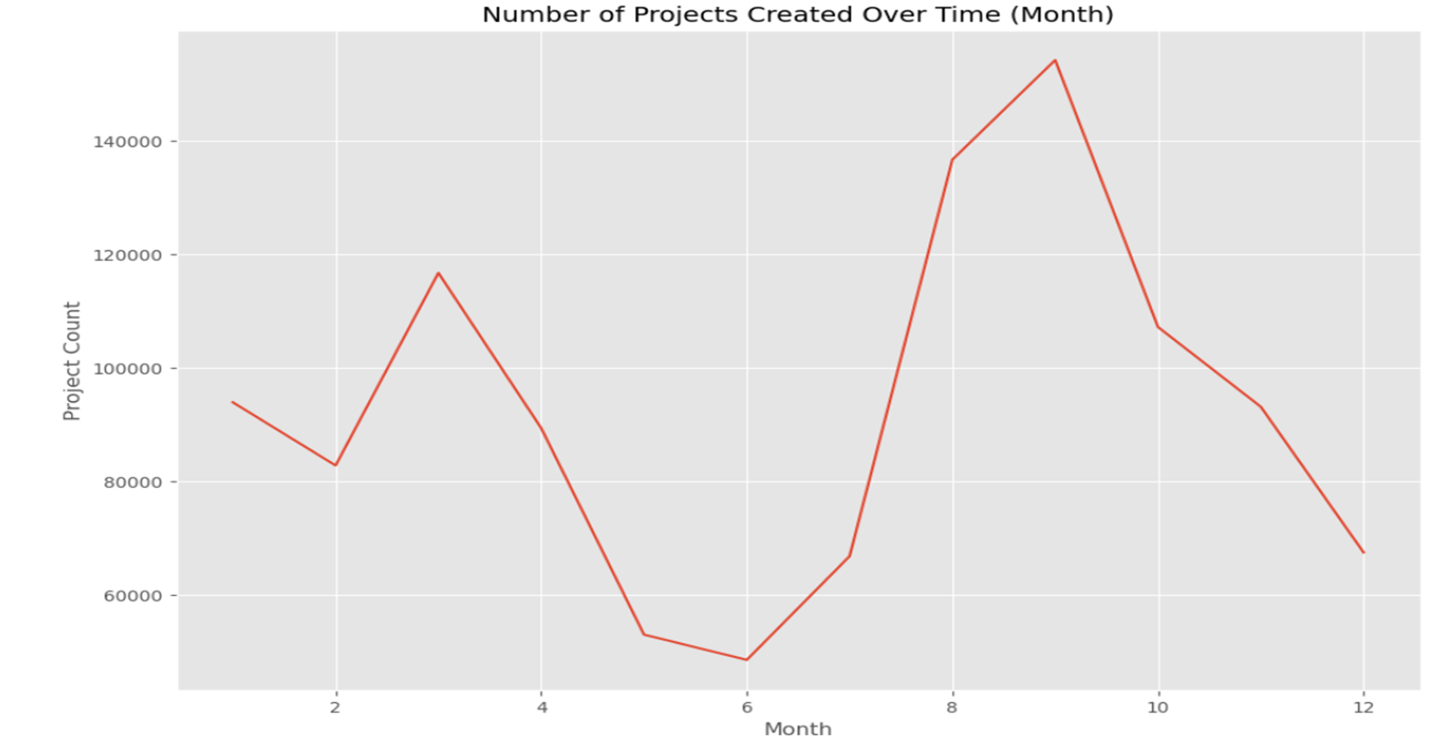
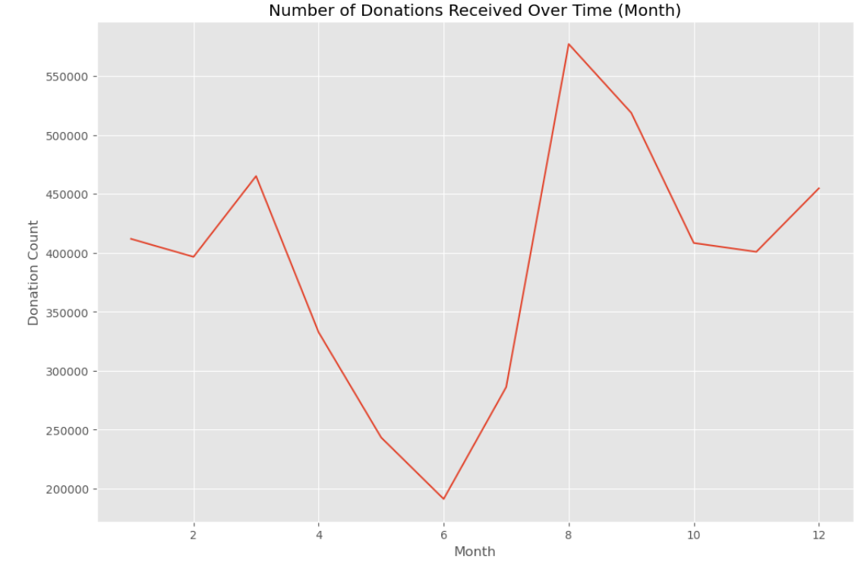
donation activity over time (by month)

Slide 14
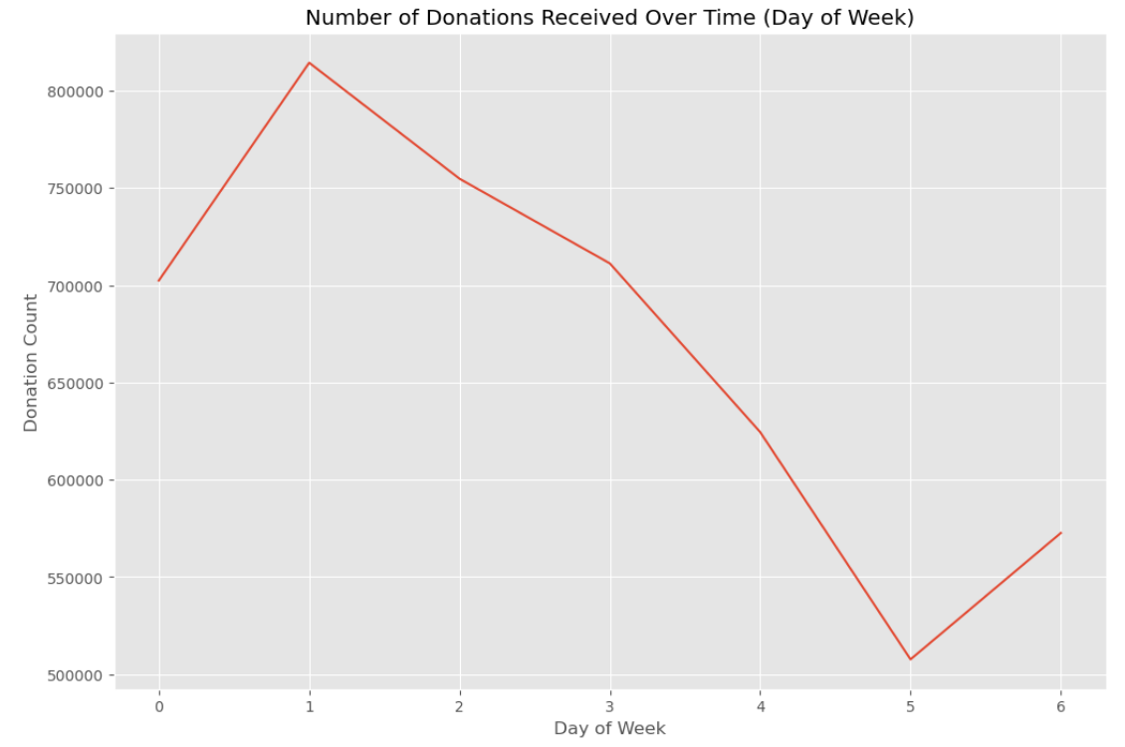
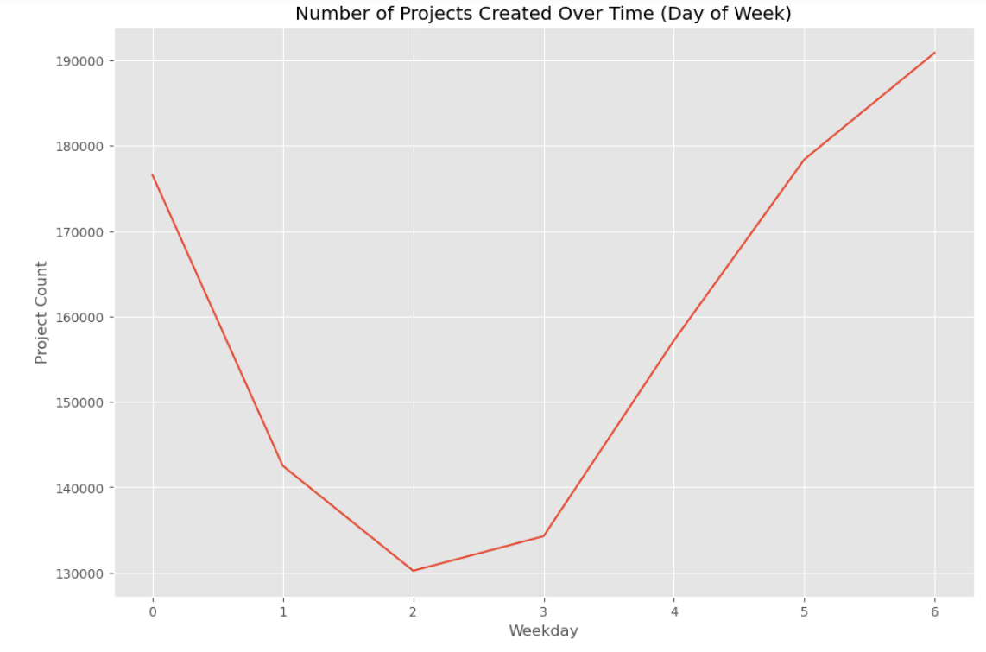
donation activity over time (by weekday)

Slide 15
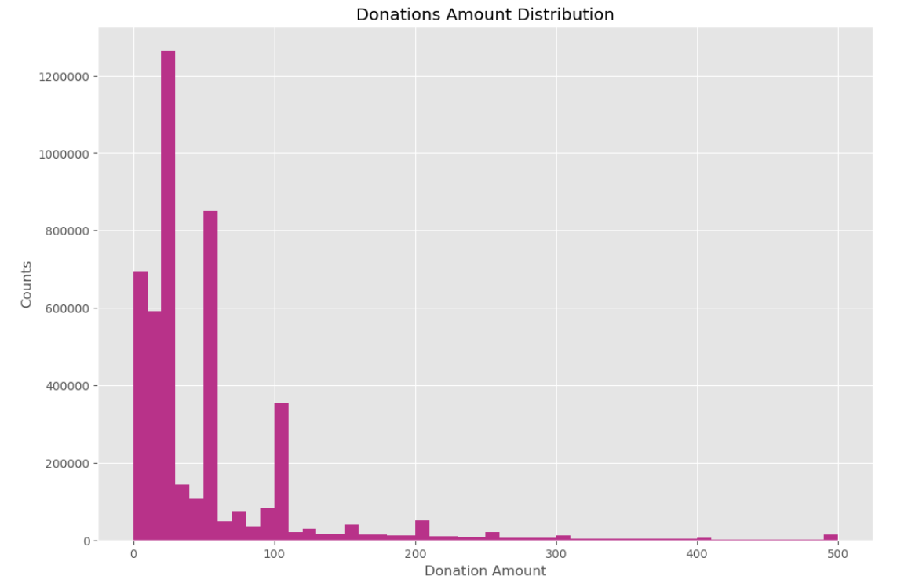
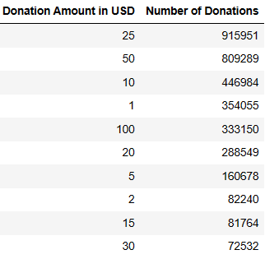
Distribution of donation amounts received

Slide 16
Donor summary

Slide 17
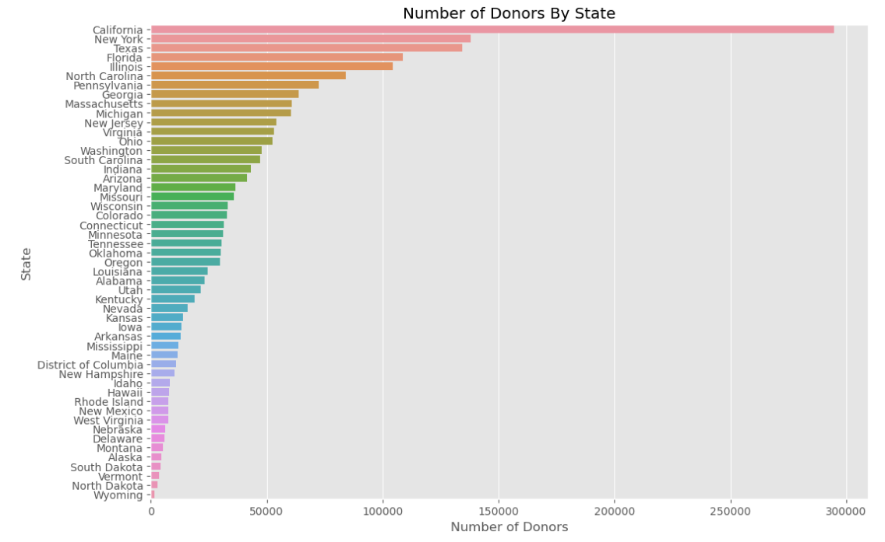
Where are donors located?

Slide 18
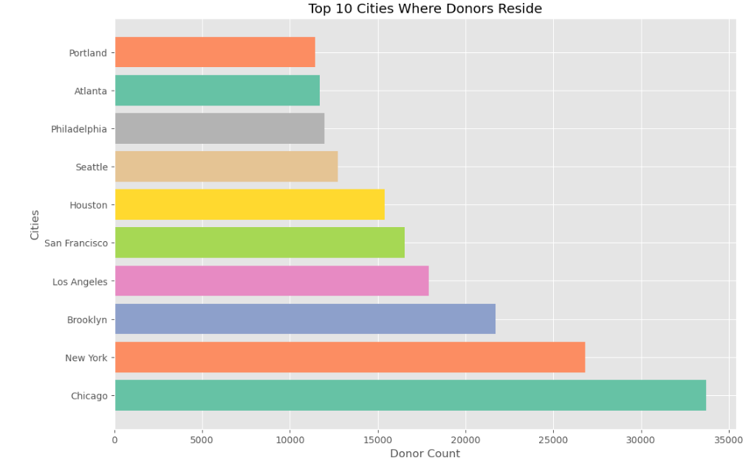
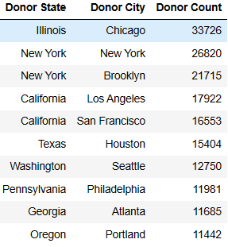
Top cities Where donors reside

Slide 19
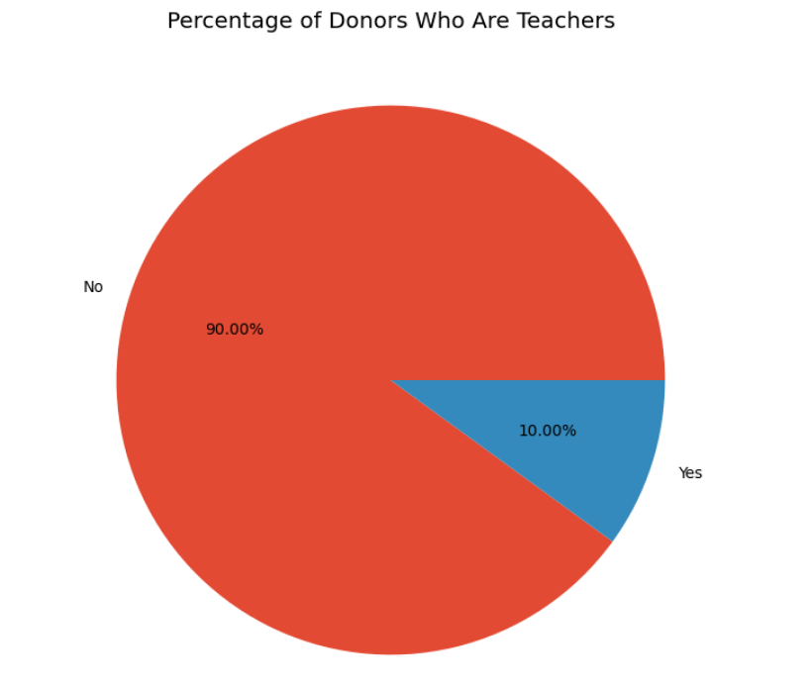
Identifying donors who are teachers
Not a Teacher
Teacher

Slide 20
Project insights

Slide 21
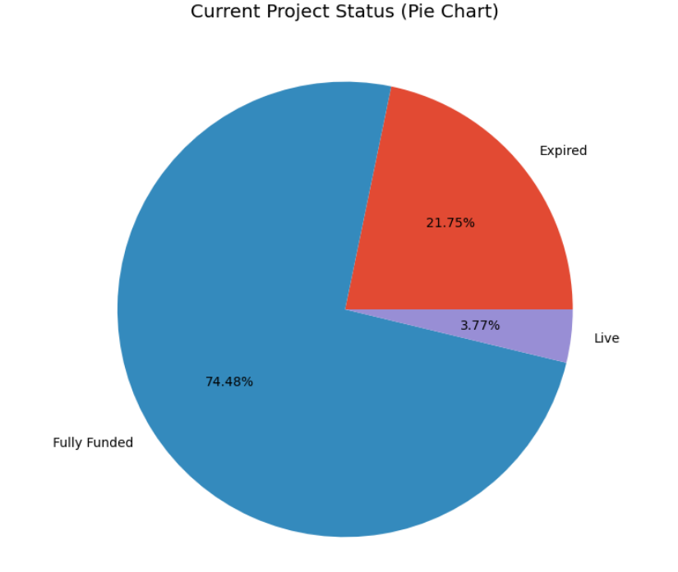
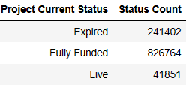
project Productivity

Slide 22
A glance at the numbers
Average amount of days projects that do not get fully funded are available: 113
Average amount of days it takes for projects to become fully funded: 29

Slide 23
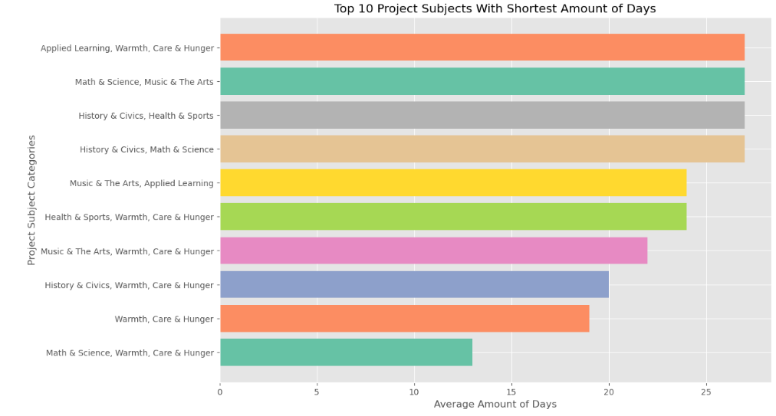
Productivity of Fully Funded projects
On average, it takes 29 days for projects to become fully funded

Slide 24
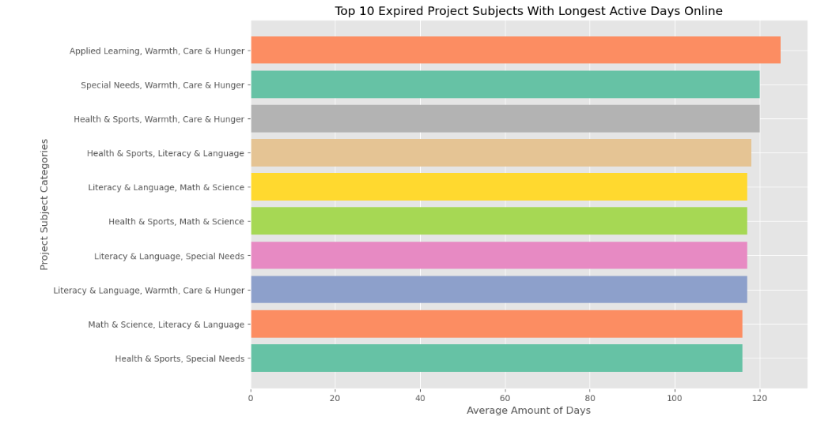
Productivity of Expired projects

Slide 25
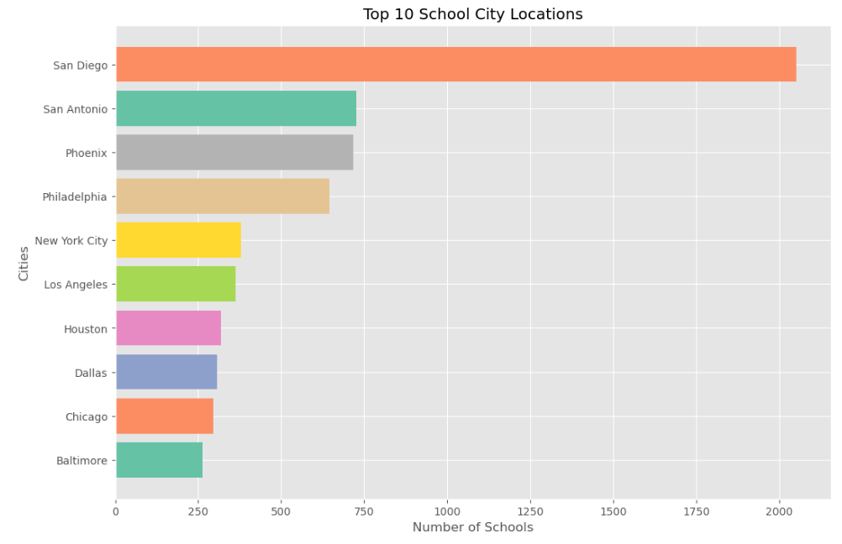
Top 10 cities with donor requests
Notes:
9 out the top ten cities saw the most diverse growth in population between 2010s, especially among their youth

Slide 26
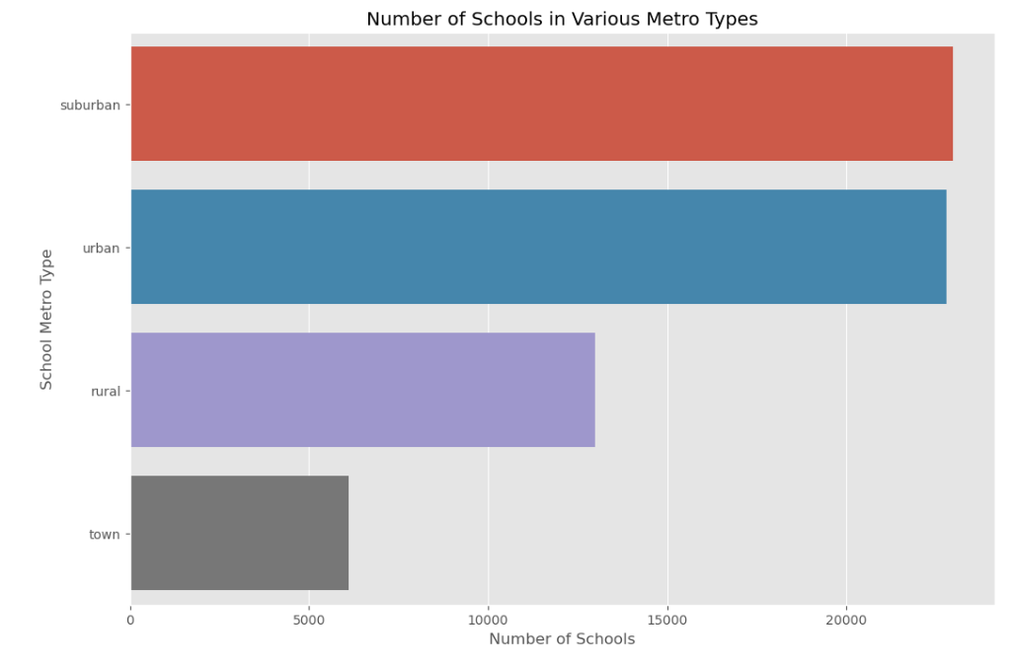
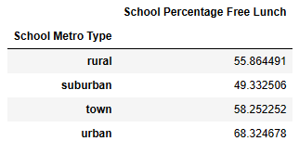
Insights on Public school participation
Notes:
Research suggests that participating urban schools are in low-income areas

Slide 27
Conclusion

Slide 28
Conclusion
Would suggest exploring:
Where top donors reside and the school metro type(s) they contribute to the most
The nature of donor participation and retention (project categories that received the most donations)
Ways in which data can be used to suggest certain projects that resonate with donor behavior to increase likelihood of projects being fully funded

Slide 29
THANK YOU
LinkedIn: Kerristen Brooks
kbtheanalyst@gmail.com
Portfolio: linktr.ee/kbtheanalyst

